Slide 1

MicroProfile
microservices made easy

Slide 2

# whoami
Martin Štefanko
Software engineer 3+ years, Red Hat
@xstefank
#devconfcz
#microprofile
@xstefank
@RedHat

Slide 3
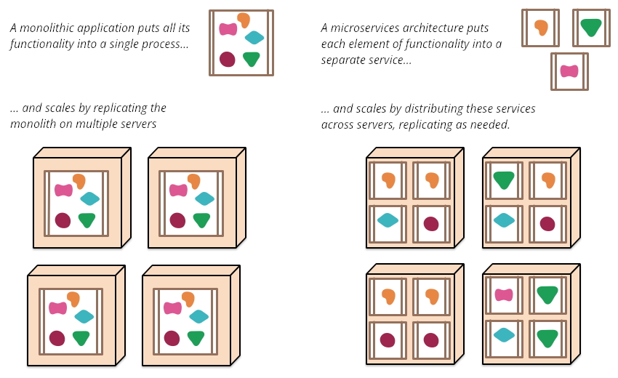
https://martinfowler.com/articles/microservices.html
#devconfcz
#microprofile
@xstefank
@RedHat
Notes:
- developed, tested, scaled and deployed independently
- public API / interface
- faster and more stable releases

Slide 4


Enterprise Java in past 20 years
Java EE (currently Jakarta EE)
  Java EE 5 - May 11, 2006
  Java EE 6 - December 10, 2009
  Java EE 7 - June 12, 2013
  Java EE 8 - August 31, 2017
#devconfcz
#microprofile
@xstefank
@RedHat

Slide 5
MicroProfile
Eclipse MicroProfile is an open-source community specification for Enterprise Java microservices
A community of individuals, organizations, and vendors collaborating within an open source (Eclipse) project to bring microservices to the Enterprise Java community
#devconfcz
#microprofile
@xstefank
@RedHat
Notes:
- eclipse - over 350 projects

Slide 6
sadf

